Slide 1

Federate Search from Facebook and Twitter
Kurt Holliday – kth11
Gangeshwari Rajavelu – gar43
Maggie Shipley – mps42
Hao Wu – haw65

Slide 2
Problem
Facebook and Twitter are separate social networks that frequently post similar content about people, places, events, and subjects. Users can search on either site, but must separately log into each site to perform the search.

Slide 3
Solution
Create a basic application to search Facebook and Twitter and return the results in one interface display.

Slide 4
User Input => Combined Output
The application will take a query from a user and return a result from both Facebook and Twitter.
Results will be weighted and ranked into one coherent interface and display.
Results will indicate which site it originated from.

Slide 5
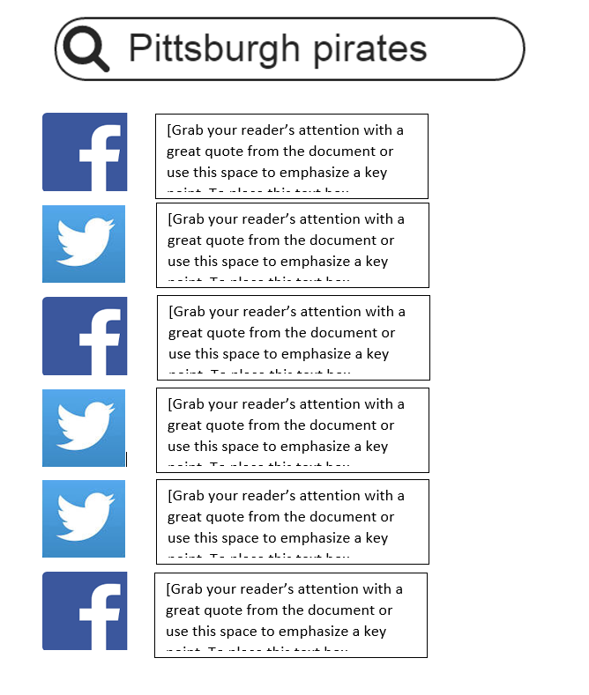
Sample of the final merged return

Slide 6
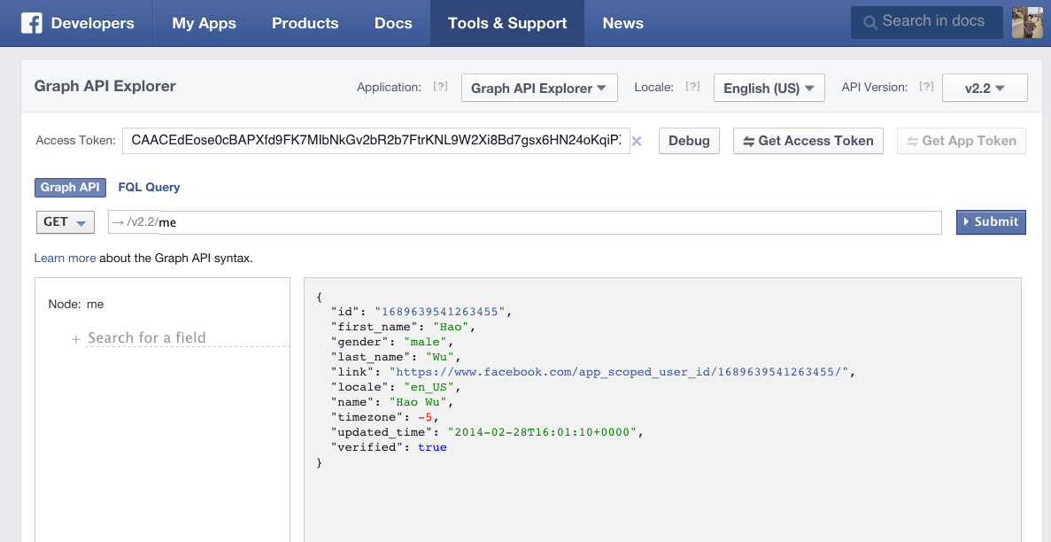
API used-1. Facebook Graph
Facebook Graph API

Slide 7
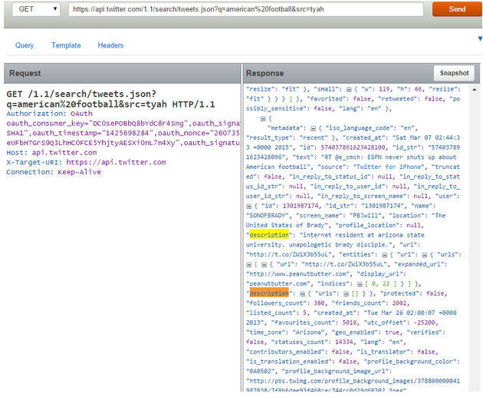
API used -2 Twitter Search

Slide 8
Library will be used
Facebook4J
http://facebook4j.org/en/index.html
Twitter4J
http://twitter4j.org/en/index.html

Slide 9
Ranking approaches
Query Likelyhood Model
rank the posts by how likely the query is generated from document language model.

Slide 10
Challenges
Users will need a way to log in before searching
Each site uses a different API
Facebook posts can be longer than Twitter posts
Must be accounted for during ranking

Slide 11
Project Milestones
Outline scope of project
Document the user process and the application process that must occur to generate the end results
Research API for Facebook and Twitter
Test APIs by creating two simple tests that sends a sample query:
…to Facebook and returns a dataset, and
…to Twitter and returns a dataset
Create a simple interface that has a Facebook/Twitter login and a search query box for the user.
Test sending the query to Facebook/Twitter directly from the interface.
Combine datasets to return weighted and relevance ranked results

Slide 12
Project Milestones
Outline scope of project
Document the user process and the application process that must occur to generate the end results
» Research API for Facebook and Twitter ›Partially completed. Broad overview research completed.
Test APIs by creating two simple tests that sends a sample query:
…to Facebook and returns a dataset, and
…to Twitter and returns a dataset
Create a simple interface that has a Facebook/Twitter login and a search query box for the user.
Test sending the query to Facebook/Twitter directly from the interface.
Combine datasets to return weighted and relevance ranked results

Slide 13
Schedule
3/9 Finish API Research
3/16 API Testing
3/23 Interface Development
3/30 Advanced API Testing
4/6 Result Ranking and Weighting
4/13 Documentation and Debugging
4/20 Project Presentation

